Slide 1
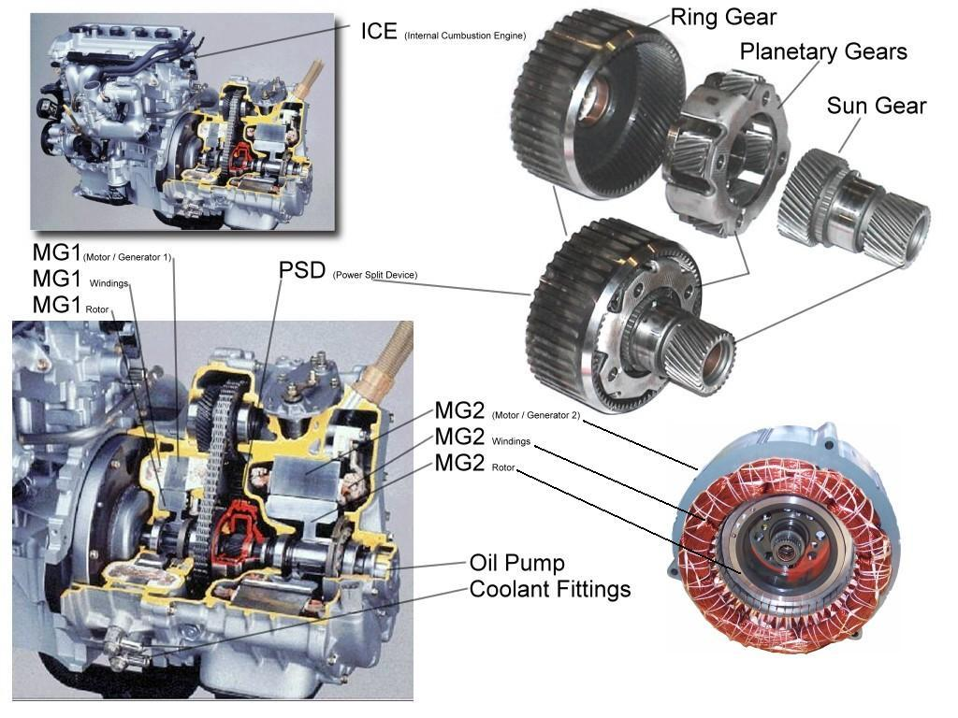
Toyota Prius Planetary Gear System

Slide 2











Planetary Gear Set Study
A
At point A:
B
At point B:
Combine:
In addition:
(1)

Slide 3
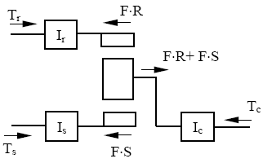






Planetary Gear Set Study
T, ω +
Assume small gear inertia:
Similarly:
Then:
(2)

Slide 4


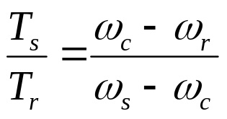

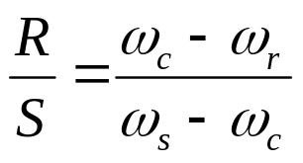

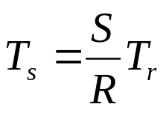
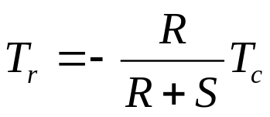

Planetary Gear Set Study
(1)
(2)
(3)
2 sub in 3:
From 1:
Then:
Sub in 2:
(4)
(5)

Slide 5
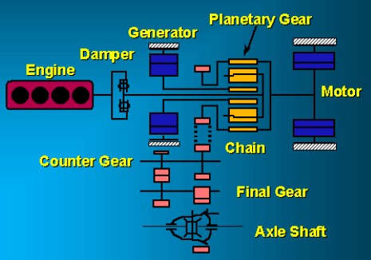
Toyota Prius Planetary Gear System
Dave Hermance. Executive Engineer. “Toyota Hybrid System” Toyota Technical Center

Slide 6
Dynamic Model
T, ω +
T_{f}
T_{m}
T_{r}
M
K
I_{m}
T_{c}
T_{e}
I_{g}
I_{e}
T_{g}
T_{s}
Assumptions: No friction lost, small gear inertia
Vehicle longitudinal dynamics only

Slide 7



T, ω +
T_{c}
T_{e}
I_{e}
(6)

Slide 8



T, ω +
I_{g}
T_{g}
T_{s}
(7)

Slide 9
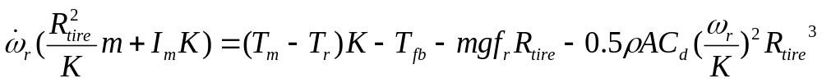

T, ω +
T_{f}
T_{m}
T_{r}
M
K
I_{m}
(8)

Slide 10

T, ω +
T_{f}
T_{m}
T_{r}
M
K
I_{m}
T_{c}
T_{e}
I_{g}
I_{e}
T_{g}
T_{s}
(1)
(6)
(7)
(8)

Slide 11
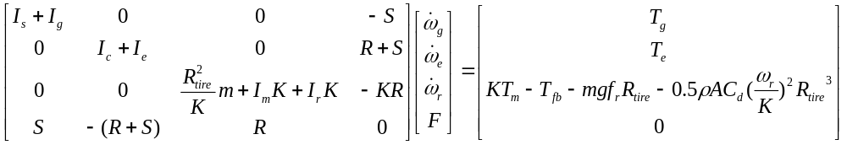


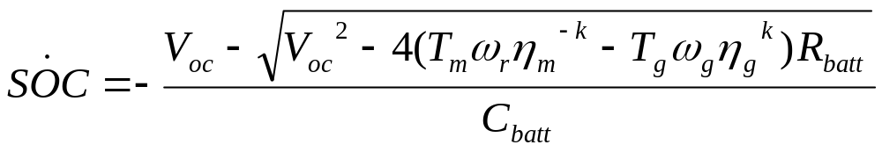
Dynamic Model
(9)
(10)
(11)
k=1 discharging; k=-1 charging

Slide 12
